Slide 1
Galleria E-Art
1. Balaji Ravindaran - 2128548
2. Gokul Raj K- 2128799
3. Jayapradaa G - 2128402
4. Sanjay Kumar S - 2128447
5. Sneka J - 2150786
DATE OF DESIGN:27-03-2023

Slide 2
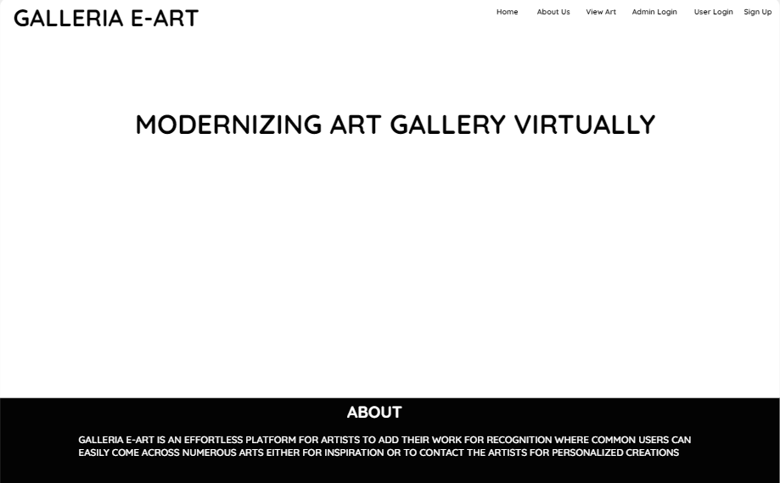
Static Home Page

Slide 3
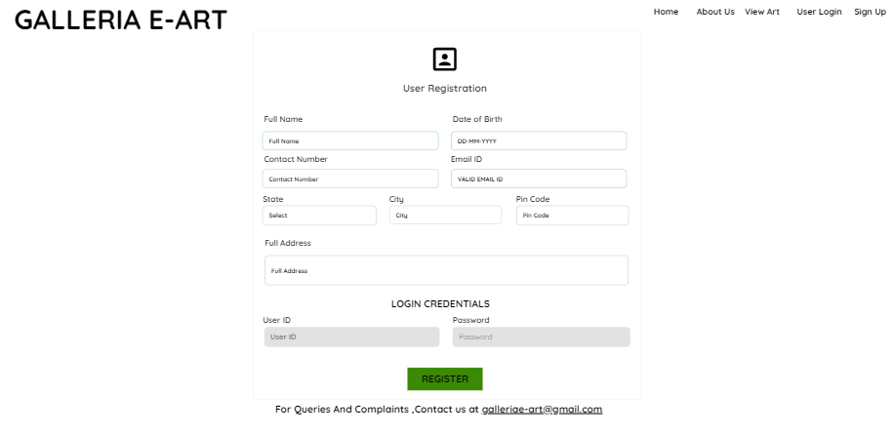
Member Registration Page

Slide 4
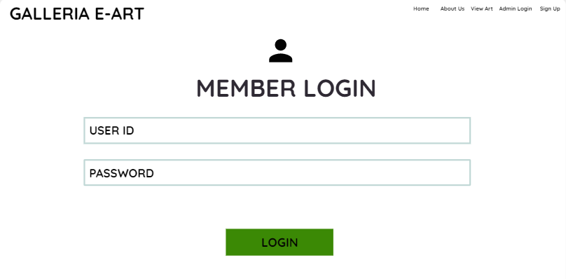
Member Login Page
3

Slide 5
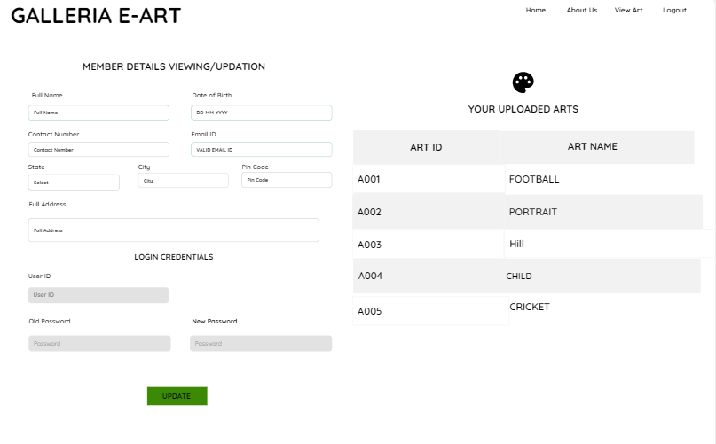
Member Profile Page

Slide 6
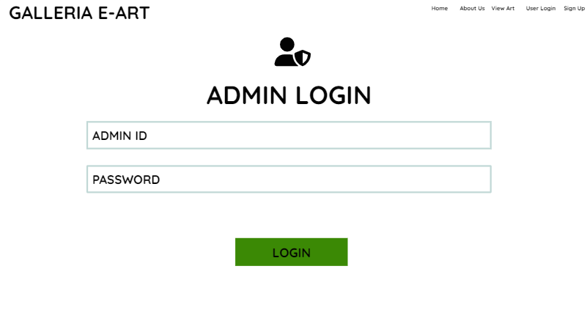
Admin Login Page

Slide 7
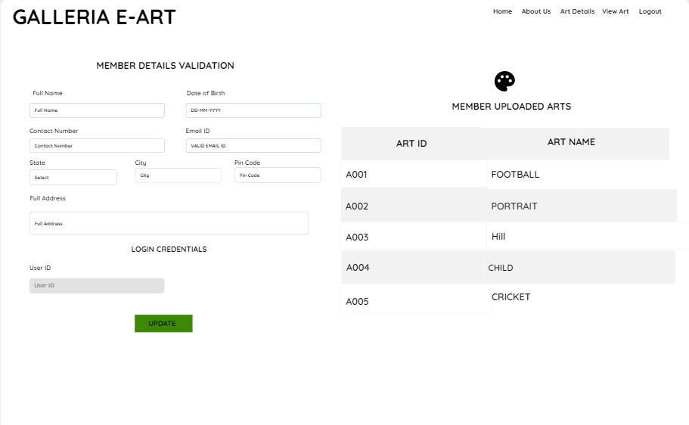
Member Validation Page

Slide 8
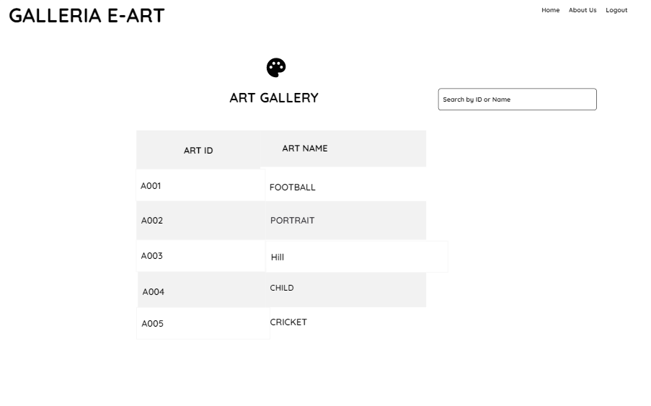
View Arts Page

Slide 9
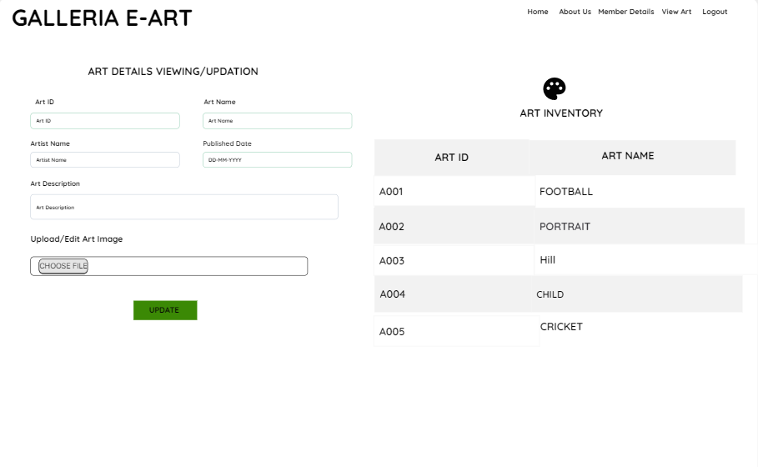
Art Management Page

Slide 10
Thank You!
POD Members
POD Member email id
1. Balaji Ravindaran 2128548@cognizant.com
2. Gokul Raj K 2128799@cognizant.com
3. Jayapradaa G 2128402@cognizant.com
4. Sanjay Kumar S 2128447@cognizant.com
5. Sneka J 2150786@cognizant.com

